Slide 1
Thursday, 19 September
17:00 – 18:00 CEST
CARBON ACT WEBINAR
Classroom Strategies for Teaching Climate Change

Slide 2
AGENDA AND SPEAKERS
Time | Agenda item
17:00 – 17:05 CEST | Welcome by the Carbon Act project
17:05 – 17:15 CEST | Scenario-Based and Interdisciplinary Learning in Teaching About Climate Change: Benefits and Challenges by Henrik Krantz
17:15 – 17:25 CEST | Together for the Climate: Reducing CO2, Shaping the Future by Marta Azevedo
17:25 – 17:35 CEST | Using TikTok for Climate Education by Mladen Sljivovic
17:35 – 17:45 CEST | Psychological Aspects of Climate Education by Katarzyna Karcz
17:45 – 18:00 CEST | Q&A Session moderated by Georgia Lascaris (Carbon Act MOOC moderator)
Notes:
As I see that more people is joining the meeting, let’s have a look at today’s agenda and a few house-keeping rules.
The webinar duration is set for an hour, where you will hear about three inspiring blue project that have achieved the European Blue School certification. These projects are reBlue from Cyprus, BluePaths from Italy, and CSI – Climate Scene Inspiration from Poland.
So we welcome our four speakers : Stella, Cristina, Erika and Tomasz. Thank you for having accepted our invite to present. It is a pleasure to have you here today.

Slide 3
THE CARBON ACT PROJECT
All mics have been disabled
Use the chat box
During Q&A: post your question in the chat
Notes:
Before we move into the first presentation, let me remind you of a few practicalities:
Note that all mics and cameras have been disabled, so in case you want to comment on something or ask questions to our speakers, please use the chat function.
We will address all your questions at the end of the webinar.

Slide 4
THE CARBON ACT PROJECT
3-year Erasmus+ project, funded by the European Commission and coordinated by European Schoolnet.
4 partners
European Schoolnet (EUN)
Institute of Geophysics Polish Academy of Sciences (IGF PAS)
Poland
The Gothenburg Region (GF)
Sweden
Center for the Promotion of Science (CPN)
Serbia

Slide 5
CARBON ACT: OBJECTIVES
Promote knowledge of climate change and sustainability actions.
Gather and organise information on any initiatives underway in schools both at primary and secondary level regarding climate change.
Support the development of teaching and learning sustainability competences.
Contribute to STEM attractiveness in schools.
Encourage schools and teachers in Europe to embrace the climate change and sustainability challenges in their education activities at all levels.
Foster pedagogical methodologies that facilitate the teaching of life sciences, such as IBSE.

Slide 6
CARBON ACT: RESOURCES
FOUNDATIONAL PHASE
CURRICULUM ANALYSIS
PILOTING PHASE
LEARNING SCENARIOS
DEPLOYMENT PHASE
EXPERT VIDEOS
MOOC
SCIENTIX AWARD
BEST PRACTICES REPORT

Slide 7
Scenario-Based and Interdisciplinary Learning in Teaching About Climat Change: Benefits and Challenges
Henrik Krantz

Slide 8
The Gothenburg Region (GR)
Consists of 13 municipalities who have chosen to
work together.
We run development projects, have government assignments, conduct reserach, organize courses and we are the voice of the metropolitan region in the western Sweden.

Slide 9
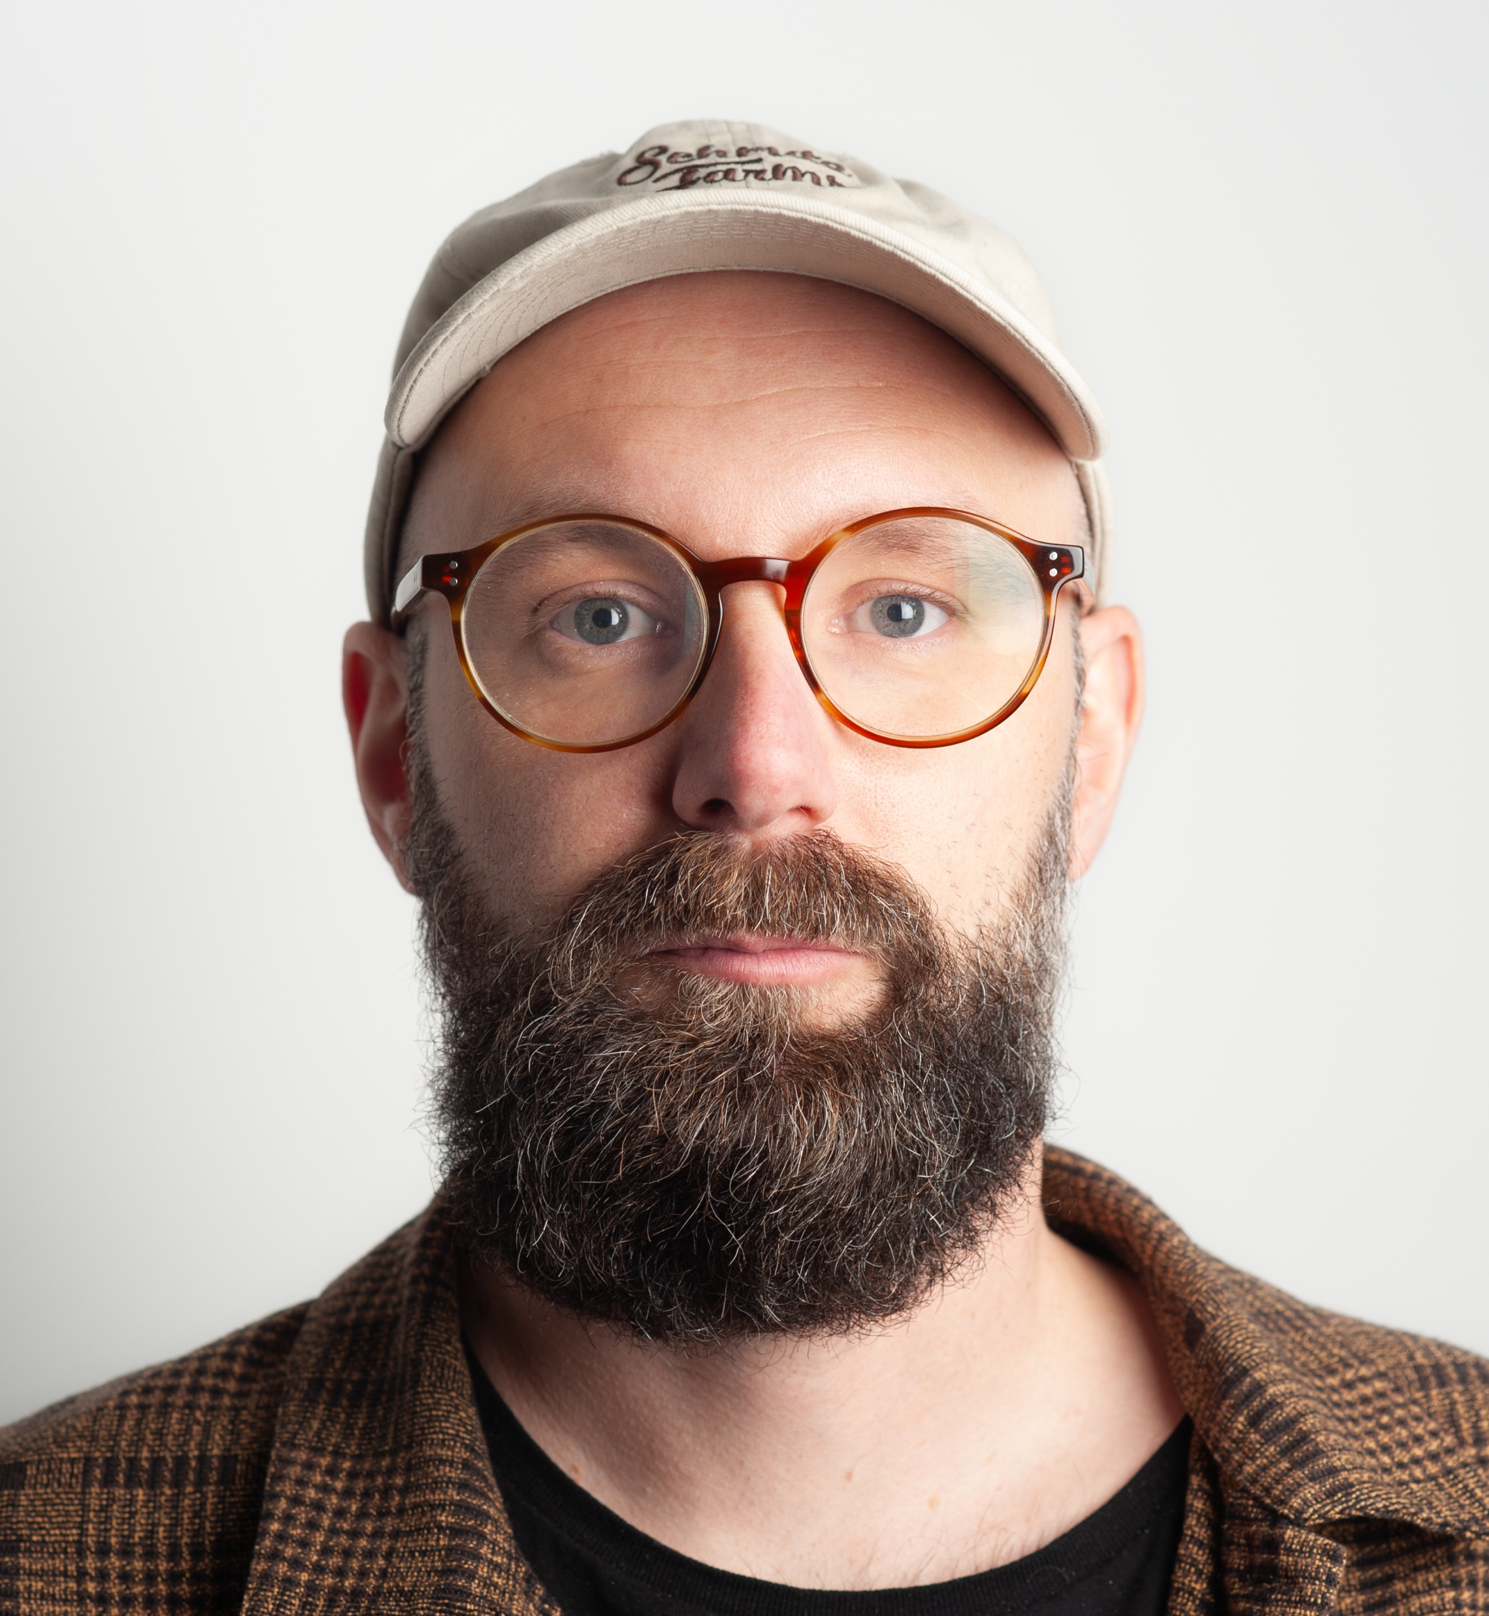
Short about me
Development leader at the department of education at GR
Former art and media teacher
Experience in game based learning, scenarios and role-playing, makerspaces and digital design

Slide 10
This presentation
Scenario-Based and Interdisciplinary Learning
What, Why and how?
Examples from Carbon Act
Benefits and Challanges

Slide 11
What?
Educational approach that integrates real-world scenarios with knowledge from multiple disciplines to enhance student learning
Students engage in realistic situations that require problem-solving, critical thinking, and decision-making, often mirroring challenges they may face in their professional or personal lives

Slide 12
Why?
Places students in real-life scenarios, making learning practical and relevant. Encourages application of knowledge to solve realistic problems.
Together with interdisciplanary teaching it enhances drawing from multiple subjects, demonstrating that real-world problems rarely fit into one discipline.

Slide 13
Requires students to think critically, make decisions, and solve complex problems in realistic contexts.
Students work with peers from different disciplines, pooling knowledge and skills to solve multifaceted problems.
Creates a more holistic learning experience, leading to better long-term retention and understanding.

Slide 14
Example from Arts, Craft & Technology
Write a story about an animal
Code a simple game from the story
Create the graphics for the game
Build a controler to play the game
Swedish
Science
Geography
Technology
Art
Crafts

Slide 15
Example
Title: Biodiversity and climate change
Author: Annelie Ängdervik
Equip students in grades 1-3 with a foundational understanding of climate change and biodiversity, fostering their sense of responsibility towards sustainable living
viewing educational films
creating factual texts about endangered species
hands-on project where students engage with local communities to construct birdhouses

Slide 16
Title: Biodiversity and climate change
Author: Annelie Ängdervik
Nature-oriented subjects
Society-oriented subjects
Arts and Craft

Slide 17
21st century skills
Critical Thinking and Problem Solving
Creativity and Innovation
Collaboration
Communication
Social Responsibility and Citizenship

Slide 18
Challenges
Planning
Time-intensive development and coordination
Resources
Subject experts and materials/simulations
Assessement
Evaluation of problem-solving and cross disciplinary skills
Student Adaptation
Cognitive overload and less structured approach

Slide 19
Best practice
Start simple
Clear objectives
Collaborative planning
Flexible assessment

Slide 20
THANK YOU!

Slide 21
Together for the Climate
Reducing CO₂, Shaping the Future
Marta Azevedo
Notes:
Thank you, Ruth.
And welcome to all the participants. In the next 10 minutes, I'm going to present the Learning Scenario that I designed and developed with my students. Together for the Climate, Reducing CO2, Shaping the Future. But first, I'd like to do a little

Slide 22
Notes:
exercise with you.
You're watching this webinar on your computer or mobile phone, right? Look at it. Are you looking? When you bought it, you certainly thought about its autonomy, its memory capacity, its visual appearance....perhaps also its cost.

Slide 23
Notes:
Not the factory, but where it came from. I'll explain further. Where did the screen come from? What material was needed to build it? Sand... And the coating? Clay? And the chips? Silicon, a common chemical element found in sand. Uou....then. Your computer or mobile phone came mainly from the beaches! What I've just done with you is the first part of my Learning Scenario....

Slide 24
Learning scenario and activities created
Engage
Think
Explore
Notes:
The Learning Scenario has 3 main activities which I've labelled: engage, think and explore.

Slide 25
Learning scenario and activities created
Why do we need Earth?
Engage
Notes:
I began by explaining to the students the activity we were going to do, posing a driven question: Why do we need Earth? Then I showed a video to engage the students: one earth. It has strong images, thriller music and is short.

Slide 26
Learning scenario and activities created
Group game
Think
Notes:
In this activity i formed groups of 4/5 people
Distribute white cardboard cards to each group. On each card, the groups should write one thing that they need to live. For example: clothes. They should then stick the cards on a board.
Then i distribute green cardboard cards. On each card, the groups should write where they can get the raw materials from the Earth to fulfil the needs they found earlier. For example: for clothes they need plants, animals... They should then stick the cards around the white ones.
Now i distribute 4 yellow cardboard cards. Each group should identify the 4 things that are most repeated on the green cards and write them on the yellow ones.
The yellow cards would now be placed on a main board. From here, start a discussion about the consequences of overuse on the environment. I focused on the responses that lead to increased CO2 production.Finnaly, on a big red card i wrote the biggest consequence of human needs: increased CO2 production and placed it in the centre of the board.
We now have a room with very colourful pictures. The students were deep in thought, so I showed another short, impactful video to summarise the ideas.

Slide 27
Learning scenario and activities created
Hands on activities
Explore
Notes:
We now move on to hands-on activities.
Basically, the students started by producing CO2. It's relatively simple. All you have to do is mix vinegar with bicarbonate of soda and collect the gas produced in balloons. The CO2 would then be poured into bottles prepared in advance with a thermometer and placed in the sun or lit with lamps. Other bottles would be in the same conditions but open. The aim was to measure the variation in temperature to see what effect the increase in CO2 had on the atmosphere. CO2, which in the previous part of this learning scenario was a consequence of human activities.

Slide 28
Aim and Outcomes
Understand the concept of climate change
Understand the consequences of the increase in CO2
Identify the impacts of human activities on Earth
Notes:
With this activity I was able to get students....
I must emphasise that the engagement of the students was remarkable. They showed genuine interest in the proposed activities, actively participating in classroom discussions and showing enthusiasm during practical activities. This created a dynamic and stimulating learning environment.

Slide 29
THANK YOU!

Slide 30
Using TikTok for Climate Education
Mladen Sljivovic

Slide 31
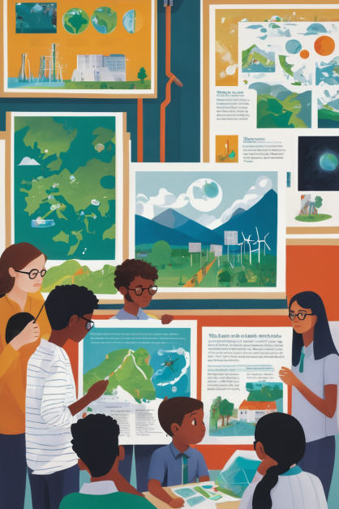
Problems
Rigid curriculum
Not many classes devoted to climate change
Not many class time for activities
Number of grades is to high

Slide 32
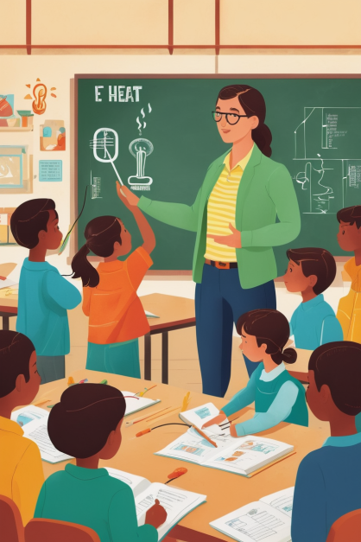
Challenge
How to trick students in to learning?

Slide 33
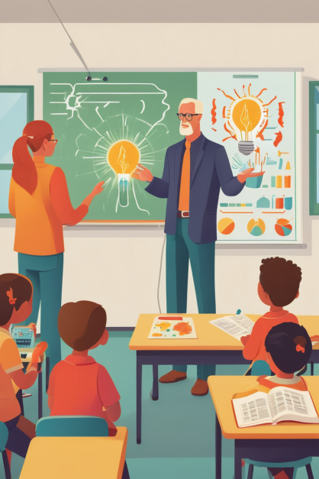
Solution
Let’s create TikTok videos

Slide 34
Task
Students got assignment to create TikTok videos that are connected to climate change and oxygen

Slide 35
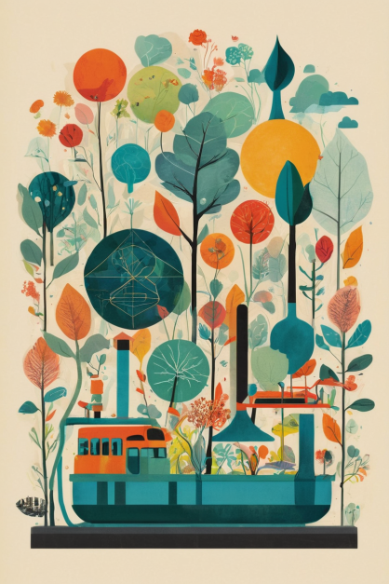
How does this work
Team of students
They choose topic for the video
Research
Consult the teacher
Film and edit video
Premiere night

Slide 36
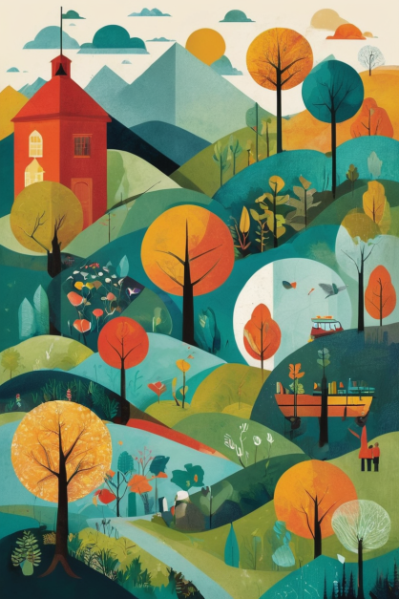
Some rules
We DON’T publish videos
When graded we take into account how much scientific accurate video is, how creative, how much effort was put into it…

Slide 37
Pros and cons
Good things:
Students get to be creative
Teacher can grade students easily
Fun way to do a research
Test indicated that students actually do

Slide 38
Pros and cons
Some difficulties :
It’s not easy to understand it well enough to make is short
Some students tend to hide behind other students work
Sometimes students think it would take less time than it would

Slide 39
oXYZa TV
Originally part of chemistry class we included biology, physics, math, IT…
Six groups of five students
Creating six videos
All part of same task

Slide 40
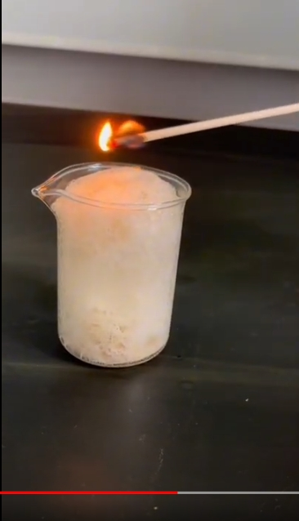
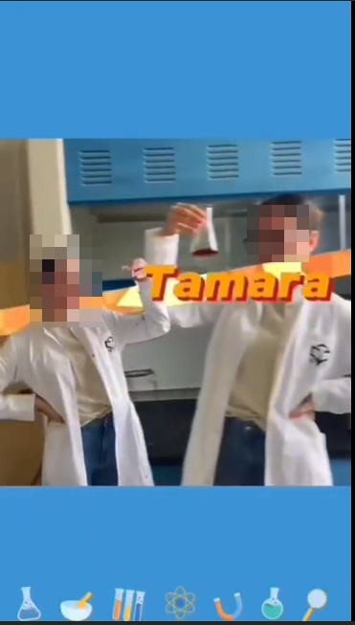
Results

Slide 41
THANK YOU!

Slide 42
Psychological Aspects
of Climate Education
Katarzyna Karcz

Slide 43
Our Carbon Act Scenario
USE YOUR IMAGINATION
by Katarzyna Karcz and Monika Jaworska
ABSTRACT
The aim of the lesson is to make students aware of the consequences of climate change and to stimulate their imagination, as well as to open a space for discussion on this topic.
PURPOSE OF THE CLASSES
1. Introducing slogans related to climate change.
2. Making students aware of projected climate changes affecting their lives.
3. Stimulating discussion and stimulating attitudes aimed at protecting nature, the environment and the climate.
EXPECTED EFFECTS OF THE CLASSES
Students' works illustrating the consequences of climate change - Poland 2023 and Poland 2050, created on the basis of articles and discussions.

Slide 44
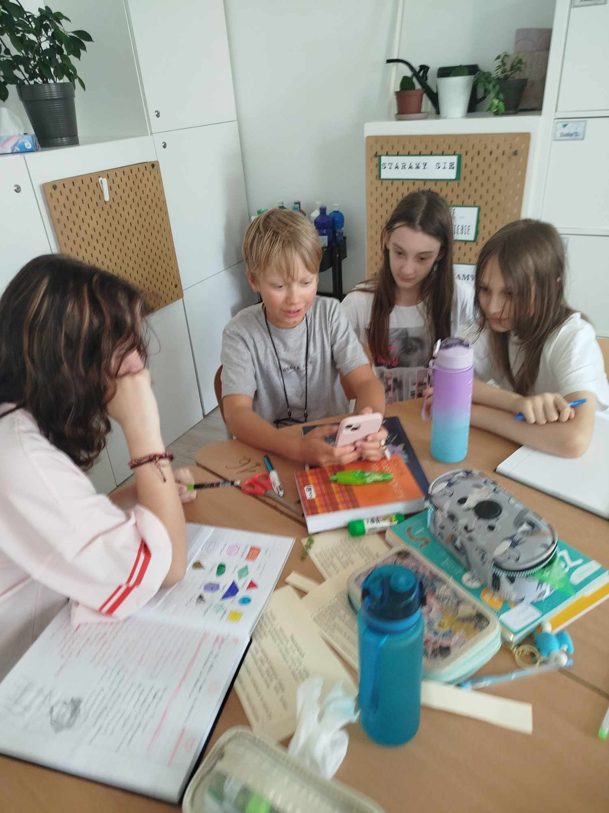
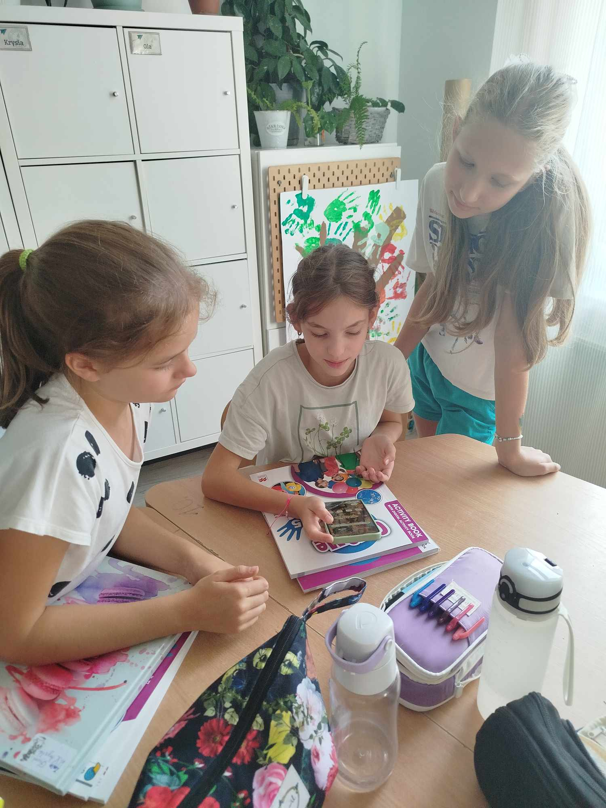
1. Students read together an article about climate changes (it’s given by the teacher).

Slide 45
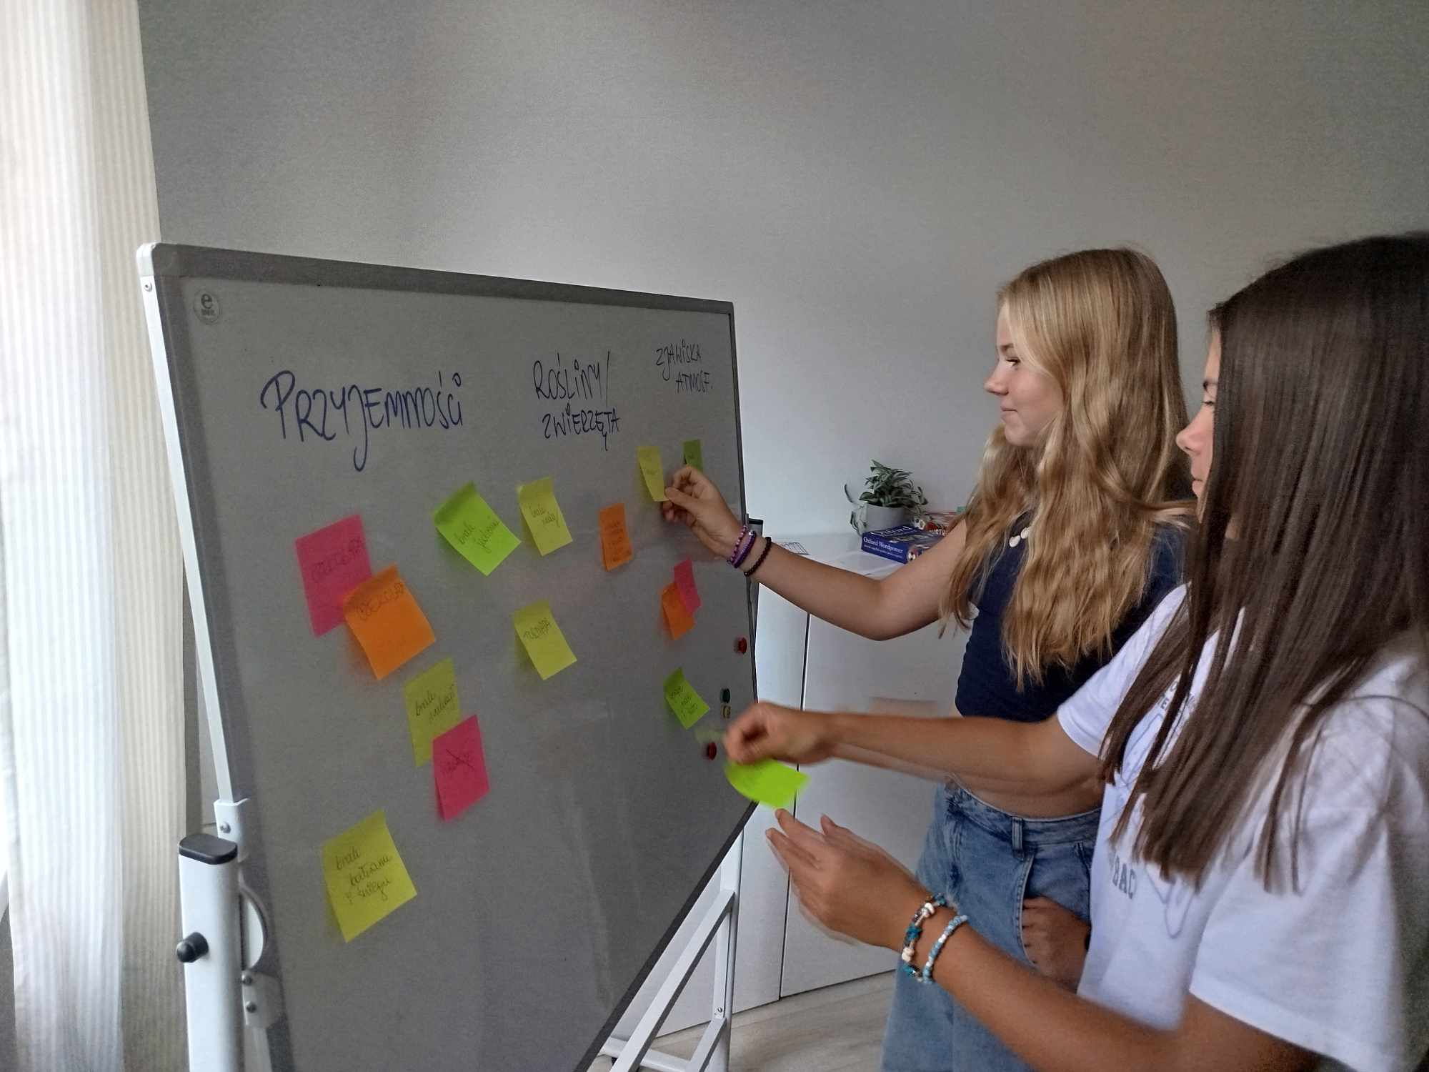
2. Kids list the most important changes from the student's perspective that may occur in the environment as a consequence of climate change. They write it on adhesive notes and attach it on a whiteboard.
3. The teacher (or a selected student) arranges the cards - similar conclusions together.

Slide 46
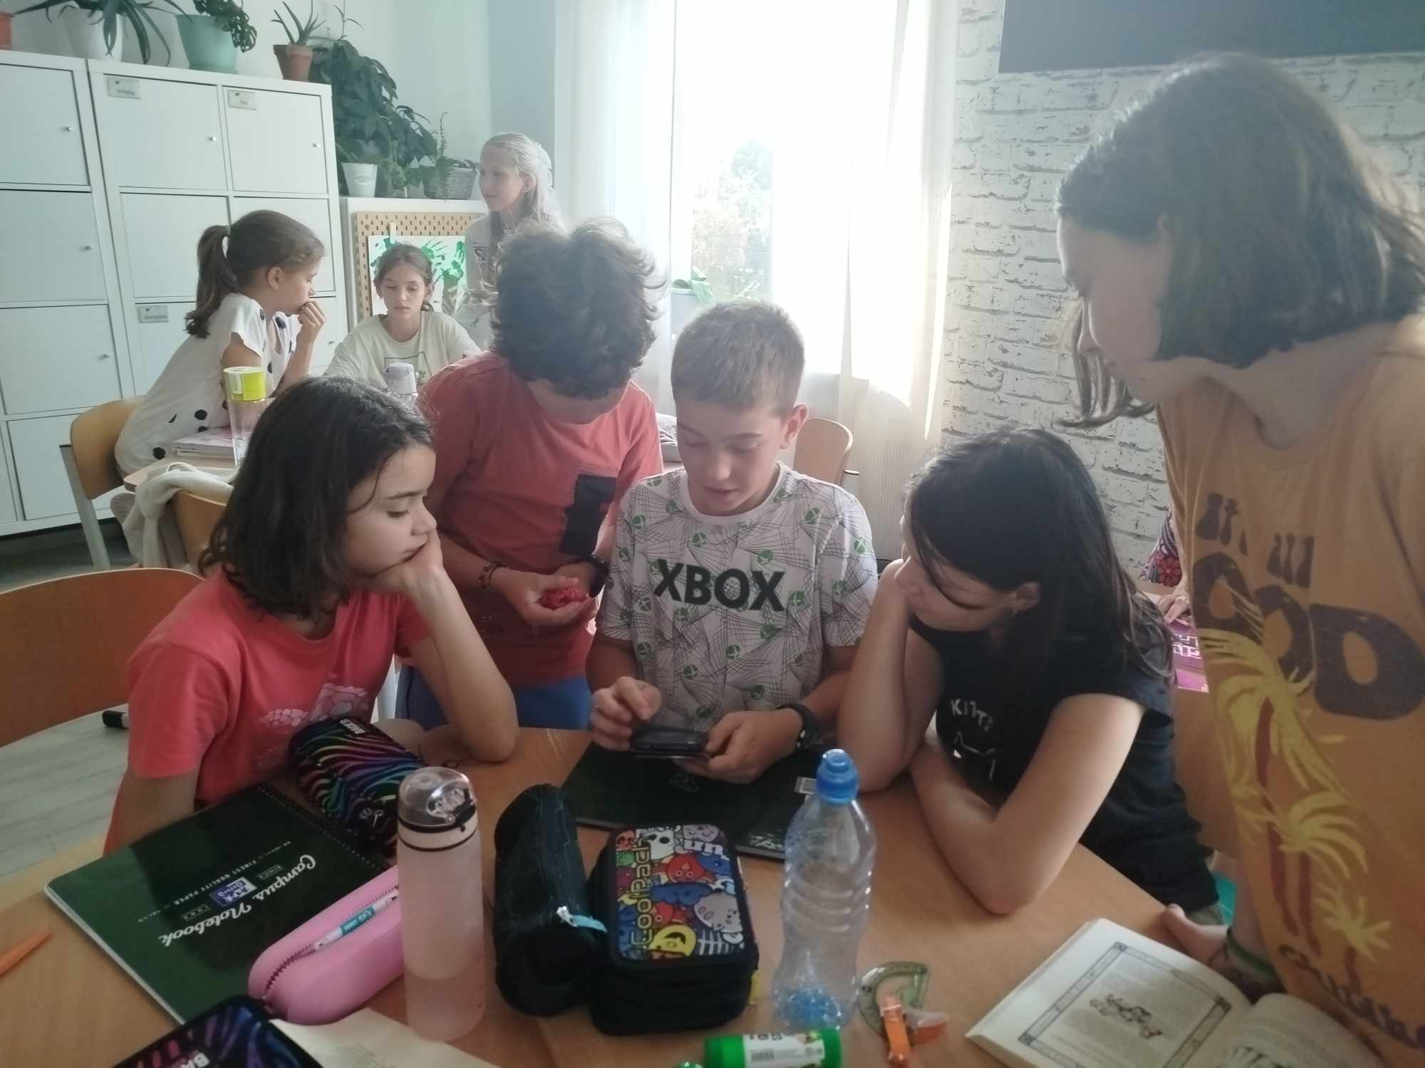
4. Under the teacher's supervision, students share their reflections on the content of the article and notes on pieces of paper.

Slide 47
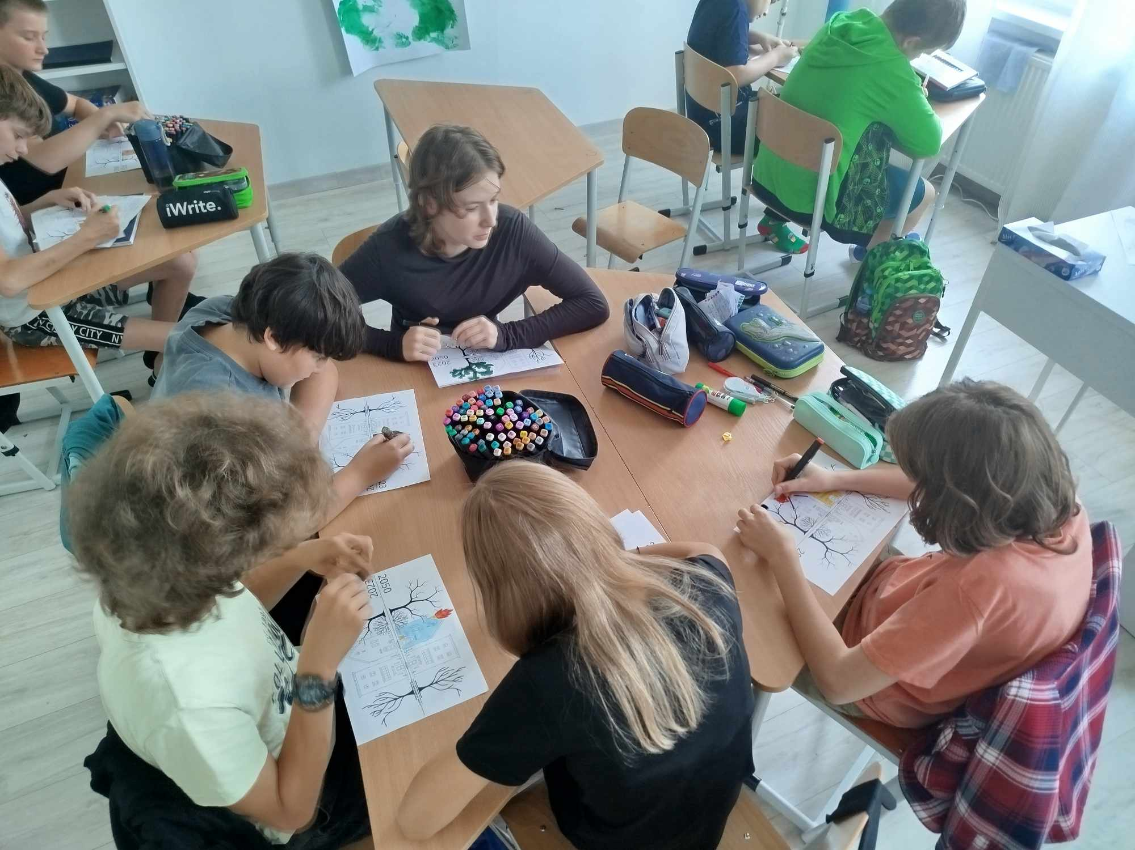
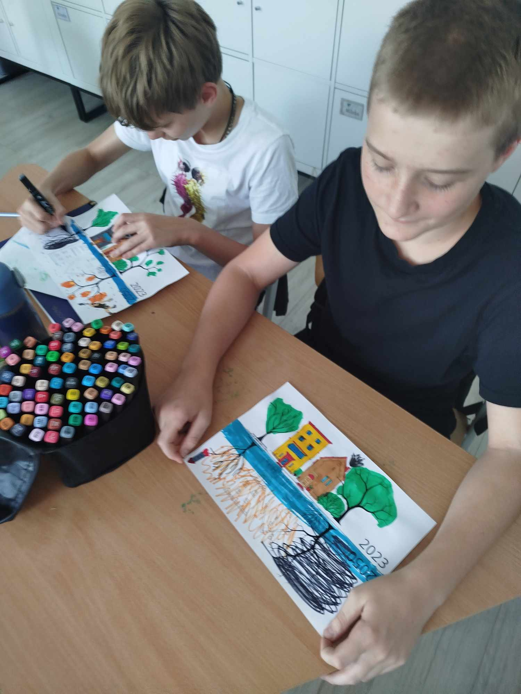

Slide 48
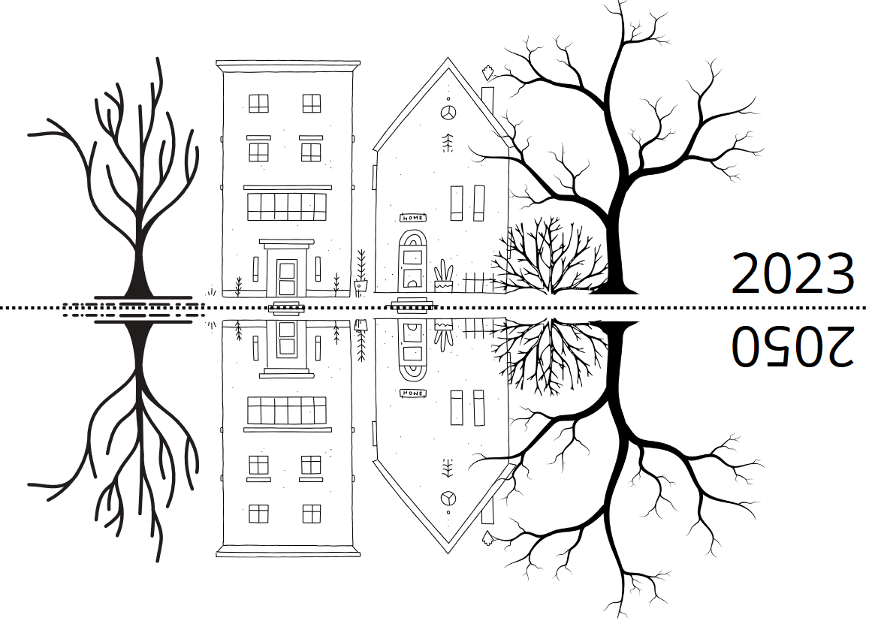
5. Studets create artistic work related with project’s topic.

Slide 49
4th grade (10 y.o.)
CLASS
In grade 4, there are children who are very aware of why and how we should take care of the environment.
ARTICLE
Children needed more time to read the article and were happy to read it in small groups.
REACTIONS
The children talked mainly about changes in their immediate surroundings. Basically, they all talked about how their house used to be on an empty plot of land near a small forest or in the middle of a meadow or field, and now a housing estate has literally grown up around them. Their stories were not about the noise around them, but about the fact that there are fewer animals, that you can no longer see the stars in the sky so well at night, and that they simply feel sorry for replacing the semi-wild ecosystem with houses, garages and cars.
DISCUSSION AND CONCLUSIONS
- Children of this age have a great need to share their knowledge. My role was mainly to organize the discussions and help organize their reports into categories.

Slide 50
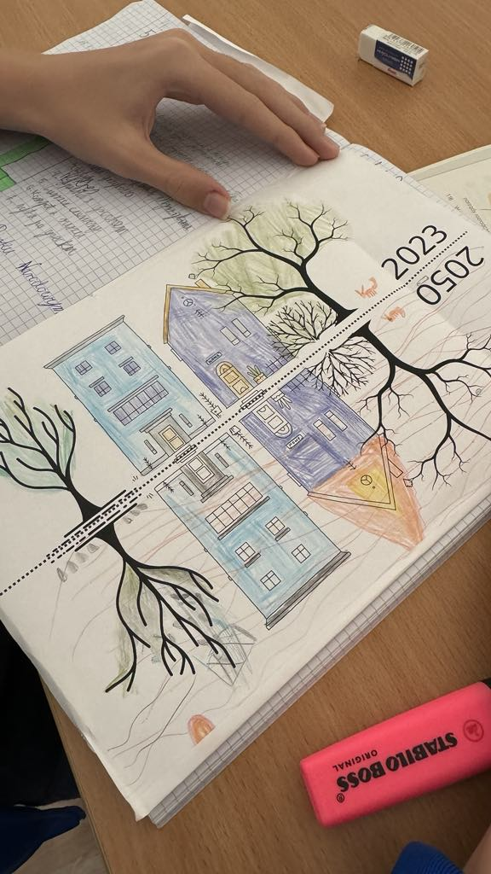
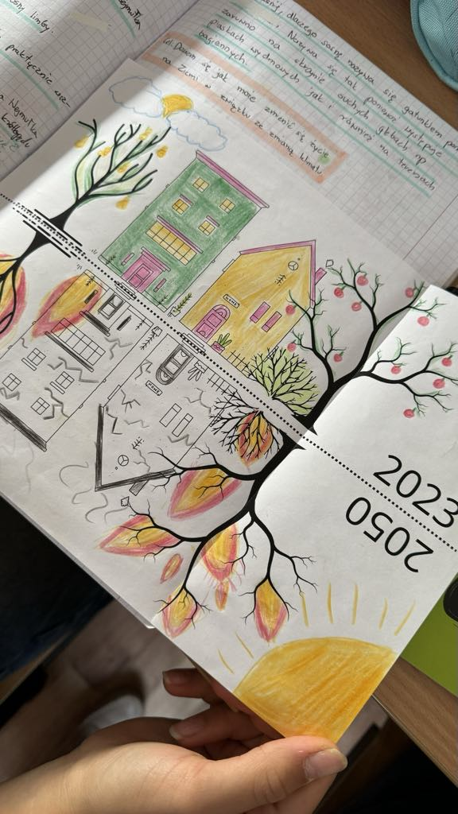

Slide 51
5th grade (11 y.o.)
CLASS
Class 5 consists of very energetic kids.
ARTICLE
The discussion between the children started while reading the article.
CHILDREN'S REACTIONS
They attached the most pieces of paper to the board. They also had the most dramatic experiences related to climate change - there were stories about garages swept away by the hurricane, destroyed trampolines, soffit torn off the roof, broken trees, damaged cars and fences.
DISCUSSION AND CONCLUSIONS
- They were excited by the number and convergence of their observations. They needed to tell their parents about the lesson.

Slide 52
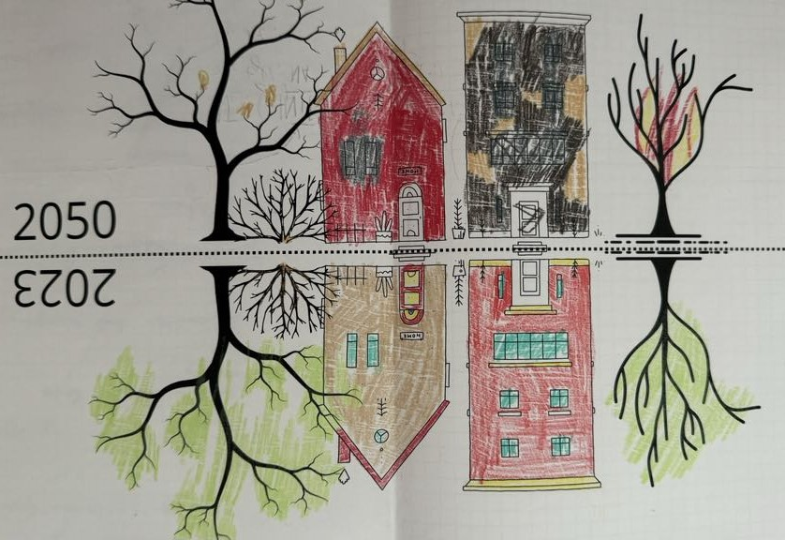

Slide 53
6th grade (12 y.o.)
CLASS
There are several extremely sensitive children in this class and those with diagnoses (including autism spectrum disorder).
ARTICLE
I had to read the article. I skipped some parts. I stopped at most paragraphs to talk about them as I went.
REACTIONS
The children reacted very emotionally, several people cried. They found the news about climate change terrifying and sad.
DISCUSSION AND CONCLUSIONS
- The discussion focused on what we can do today to live smarter and better.

Slide 54
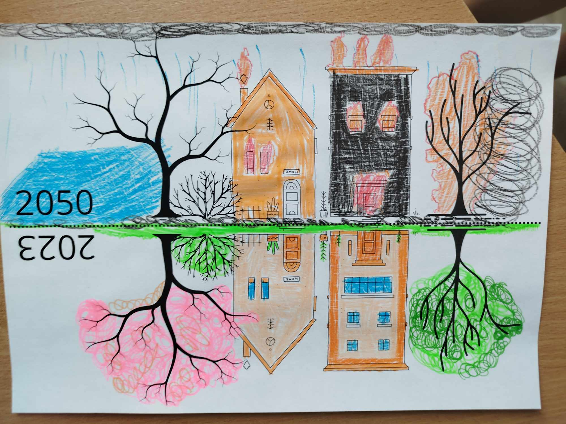

Slide 55
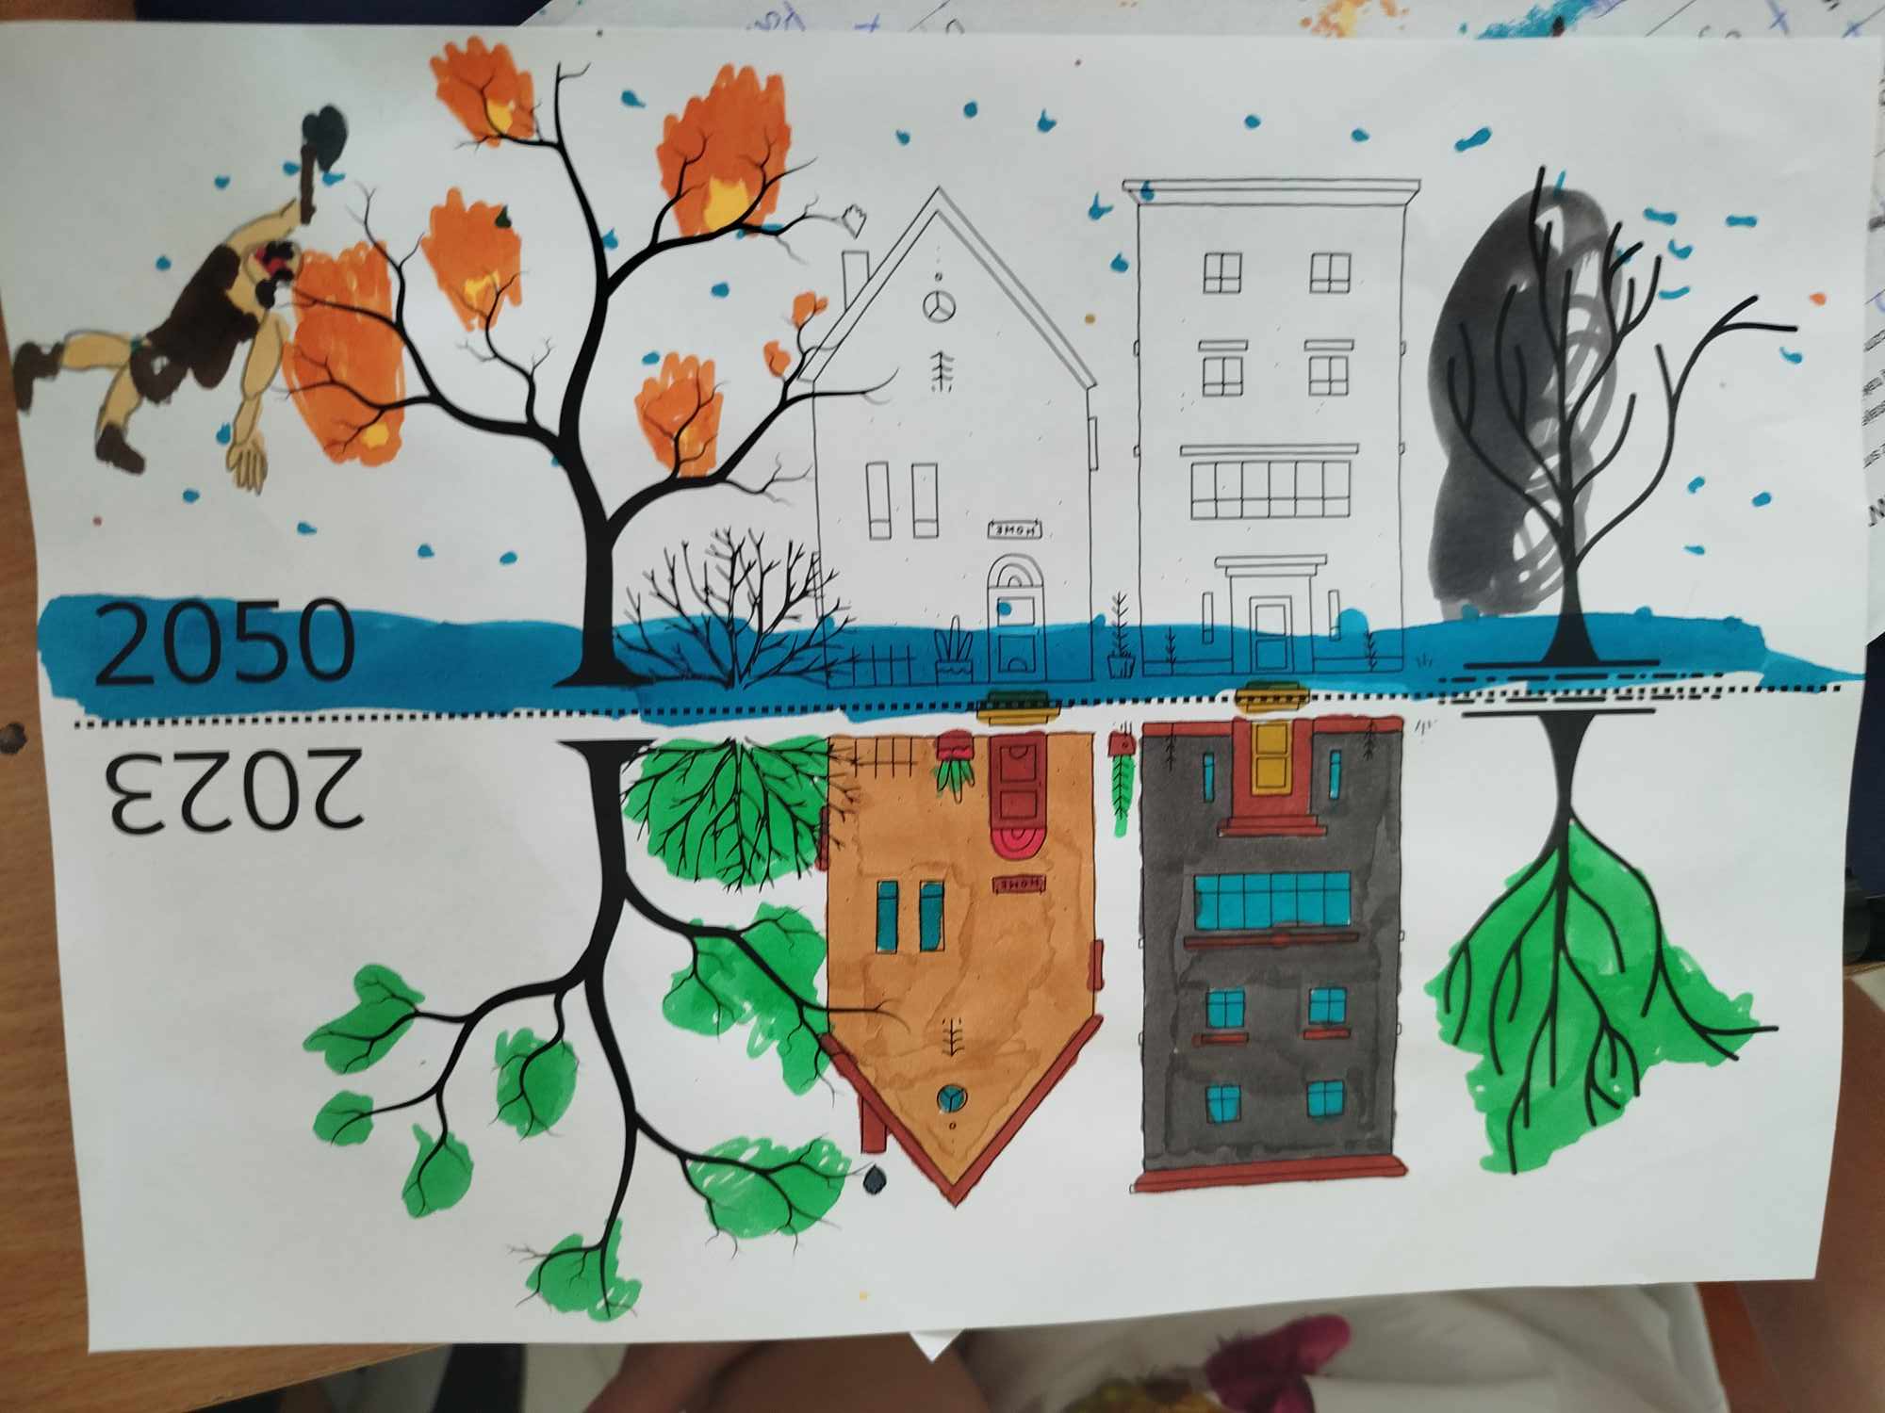

Slide 56
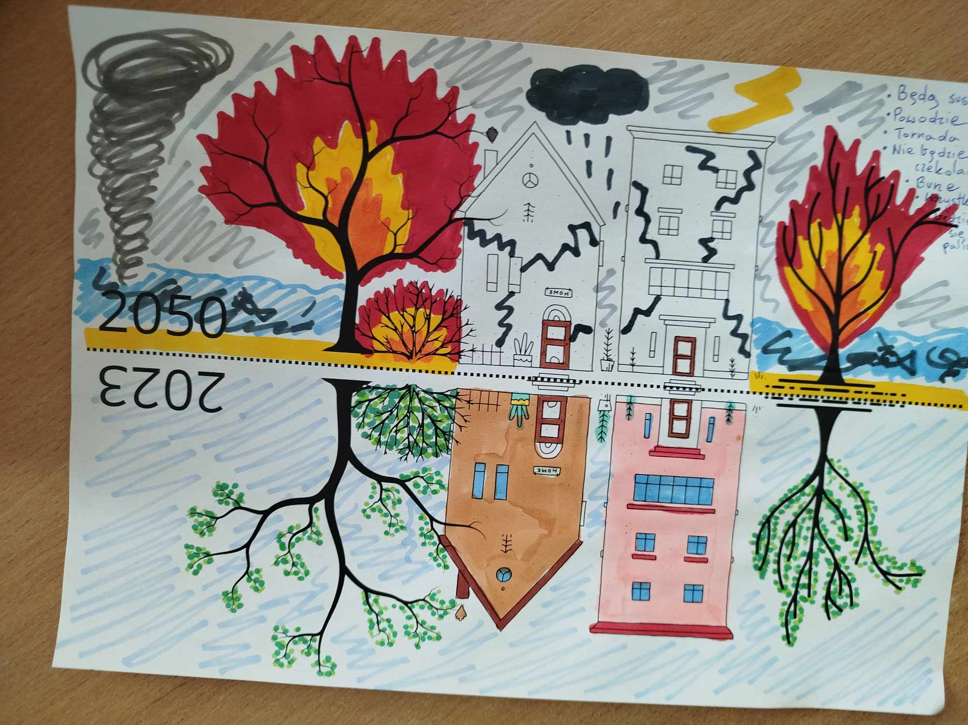

Slide 57
Summary
Unfavorable changes taking place in the environment are a difficult topic. It requires great sensitivity of the teacher, knowledge of the class and modifications during classes.
The art works of children from all classes were surprisingly similar.
The conclusions of students in all classes were identical - everyone left with the belief that a big change is the sum of small changes and with the resolution to talk to their parents about what else they can do in their home, surroundings and life.

Slide 58
THANK YOU!

Slide 59
ANY QUESTIONS?
TYPE THEM IN THE CHAT AND ASK OUR SPEAKERS!

