Slide 1
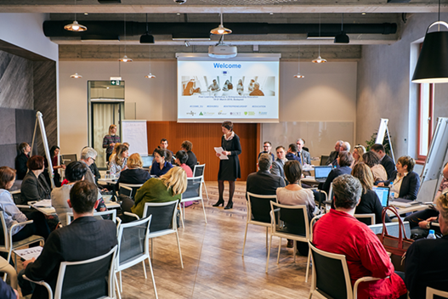
Peer-learning workshop in Entrepreneurship Education
Live Session 3
2 March 2021

Slide 2
Live Session 3
2 March, 10:00-11:00 CET - Agenda:
Opening & introduction to workshop programme 10 March (JA Europe)
Latest in the Online Community (EUN European Schoolnet)
Overview of policy recommendations available in the online community related to
AWARENESS & VISIBILITY
RESEARCH & KNOWLEDGE TRANSFER
4. Nationwide survey in Finland on entrepreneurial competences among all comprehensive school nine-graders in three successive years (2020, 2021, 2022)”, Anu Raappana, LUT University (Finland)
5. Assessment and certification of entrepreneurial competences: example of the Entrepreneurial Skills Pass (Kare Moberg, Danish Foundation for Entrepreneurship & Vera Martinho, JA Europe)
6. Q&A, discussion

Slide 3
EE peer-learning workshop 10 March
http://www.ee-hub.eu/peer-learning/entrepreneurship-education/2452-third-peer-learning-workshop-in-entrepreneurship-education.html
9 March, 16:30: Introductory session with Women’s Entrepreneurship stream
10 March, 09:00-16:00: EE peer-learning workshop

Slide 4
Online community during the workshop

Slide 5
Policy recommendations
Present a strategic vision of progress expected in the coming years and will propose a new European Agenda for Entrepreneurship Education.
The draft policy recommendation will cover six areas
INITIAL TEACHER TRAINING
CONTINUOUS PROFESSIONAL DEVELOPMENTY OF TEACHERS (CPD)
LEADERSHIP & STRATEGY
COOPERATION & NETWORKING
AWARENESS & VISIBILITY
RESEARCH & KNOWLEDGE TRANSFER

Slide 6
Policy recommendations
How Can We Best Move Entrepreneurship Education Forward in Europe? We need your input on the policy recommendations
We would like to ask your opinion on how well the national and regional recommendations / actions are followed up in your country.
For the European level, please tell us how important each recommendation is for your work.
When you have given your input, you will see the average input in % from all. You will only be able to score once. The scoring will be anonymous and the results only used in aggregated form at European level.

Slide 7
Policy recommendations Awareness and Visibility
Conclusions from the first two EE workshops and from reviving literature and research indicates:
One key issue related to integrating EE into curricula is negative connotations of entrepreneurship (capitalism or commercialism).
This includes reservations of key agents such as teachers, headmasters, professors, and students. Literature also finds that teachers raise the fear about negative effects of EE on students’ performance in other subjects and reactions from parents.
Participants in our first two EE workshops have indicated that these challenges remain a major hindrance even if we can see there is plenty knowledge on the positive impact of EE as well as on tools, methods, and impact assessment that can help provide guidance and clarity for teachers and students to accept and embrace change.
Awareness-raising will support the national EE actions ensuring that EE is properly understood as teaching competences.

Slide 8
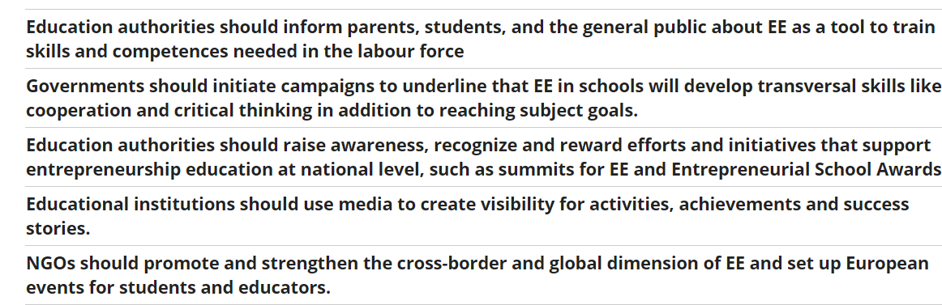
Policy recommendations Awareness and Visibility
National actions

Slide 9
Policy recommendations Awareness and Visibility

Slide 10
Policy recommendations Research and Knowledge Transfer
Pan-European research is crucial to understanding the impact of EE, and has clear added value to national research.
The pre-surveys to the two EE workshops clearly indicated a need for research about both the short-term impact of entrepreneurship education and its long-term impact e.g. on job creation and employability including dissemination of such research.
Teachers also need assessment tools and ways of evaluating students’ performance and learning outcomes. Schools and teachers need tools to monitor their own progress.

Slide 11
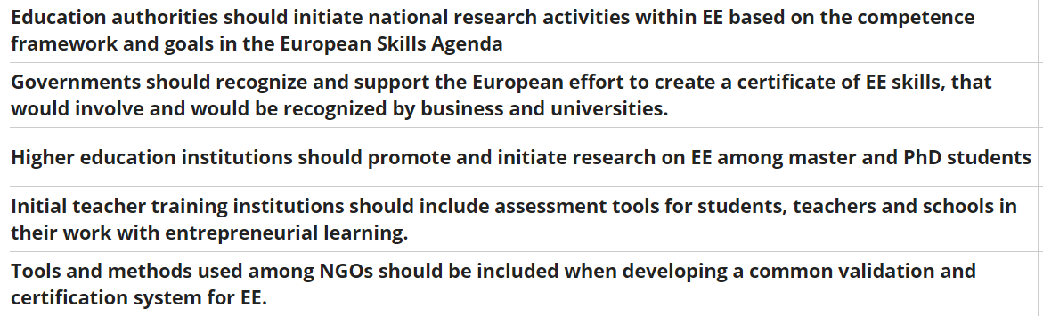
Policy recommendations Research and Knowledge Transfer National Actions

Slide 12
Policy recommendations Research and Knowledge Transfer European actions

